Slide 1

Preparing for your online interview with Cork City Council
Recruitment Section, People & Organisation Development
Notes:
Thank you for chosing to apply to work with us at cork city council. Online interview have beome an increasingly common part of the hiring process.

Slide 2
Online Interviews with Cork City Council
This video was prepared, in line with national guidance from the Local Government Management Agency, to help candidates in preparation for their online interview with Cork City Council.
Interviews will be via Microsoft Teams.
Once connected, you will be able to see
and speak with the interviewers on screen.
The following slides will help you
prepare for the interview.
Notes:
Video job interviews have become an increasingly common part of the hiring process especially since the pandemic. It is very similar to in-person or phone interview but may be a new experience for youThis respurce has been prepared in line with national guidance from the LGMA to help you prepare for your upcoming online interview with us. Online interview are similar to in person or phone interviews, and like with any interview PREPARATION is key

Slide 3




Be prepared
Internet Connection
Camera
You will need an internet connection with at least 1MB per second bandwidth. Close all other applications.
You will need a computer, tablet or mobile device with a camera.
Please test in advance your camera
is working.
Headphones
Devices
If possible wear headphones with a built-in microphone. Please test in advance your microphones and headphones are working.
Turn off all other devices in the room to avoid disruption or electronic feedback. Do not text or email during the interview.
Notes:
In advance of your scheduled interview time – be prepared – do a tch check to ensure your internet connection, your camera an your headphones are all in working order. Don’t forget to turn off all other devices in the room and close all applications other than Microsoft team on your PC/Tablet or phone

Slide 4
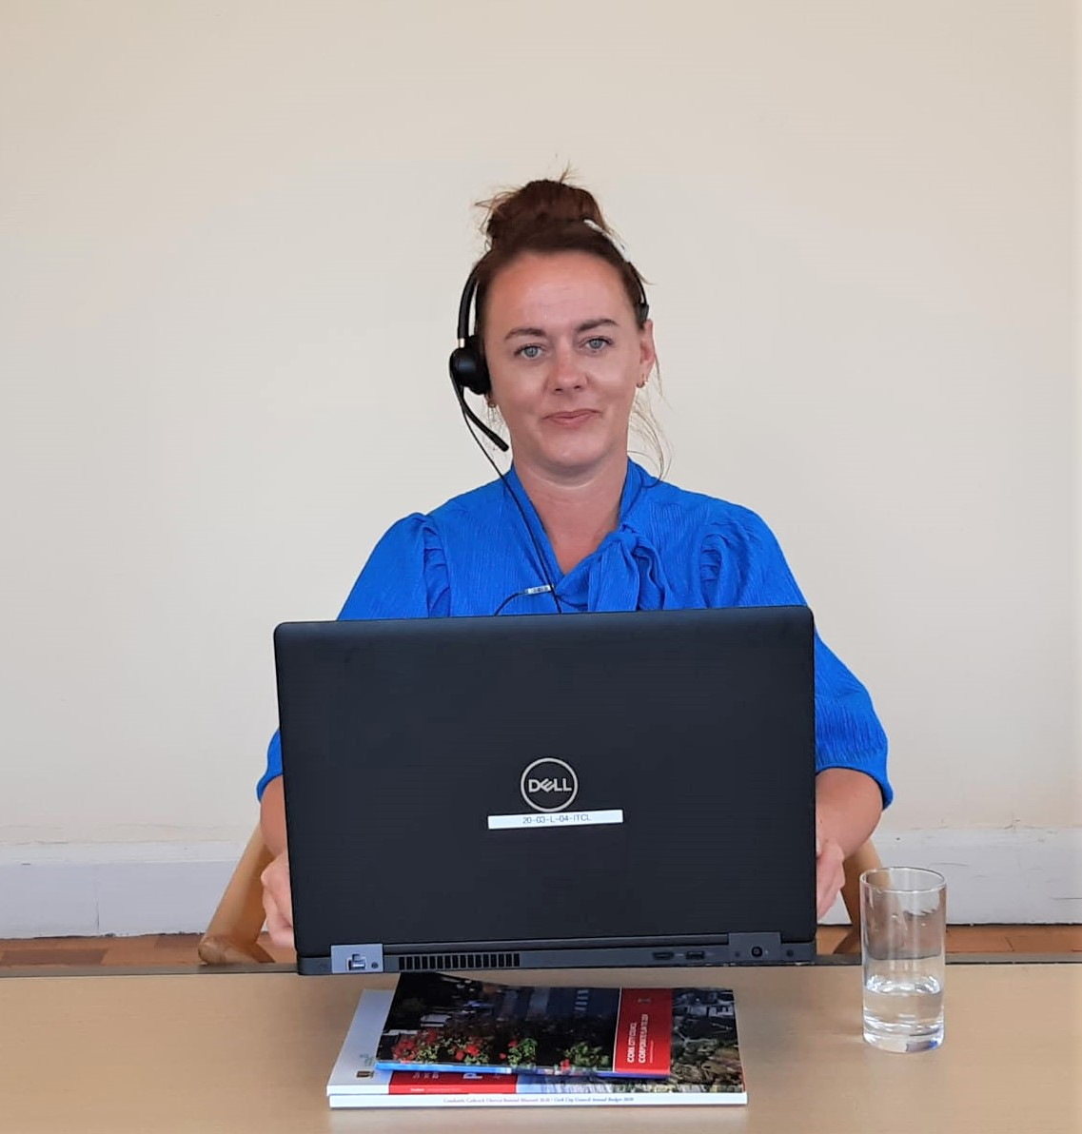
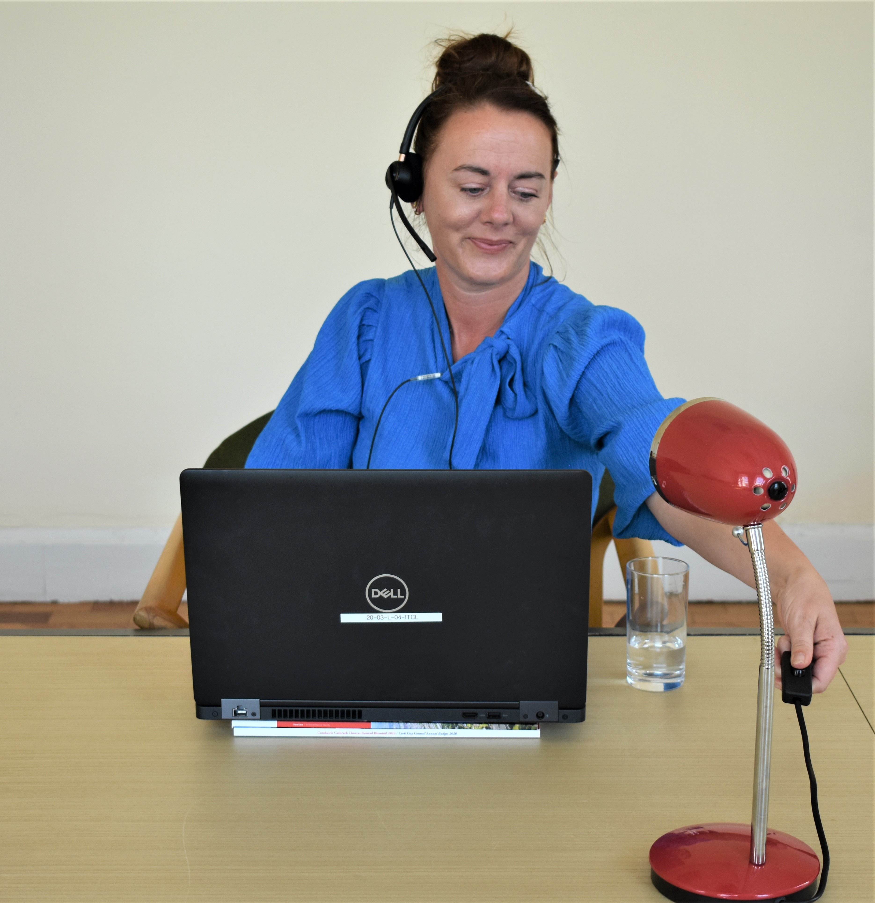
Be prepared - setting up
Position the camera so you’re looking up slightly.
Ensure your head and shoulders are seen on the screen. Use a stack of books if you need to.
Check the lighting and what is in your background. Position a lamp in front of you.
Can you see yourself on the screen?
If you can’t, neither can the interview board.
Notes:
Give yourself adequate time to set yourself up. You can use a stack of books under your device to get the correct camera angle for you

Slide 5
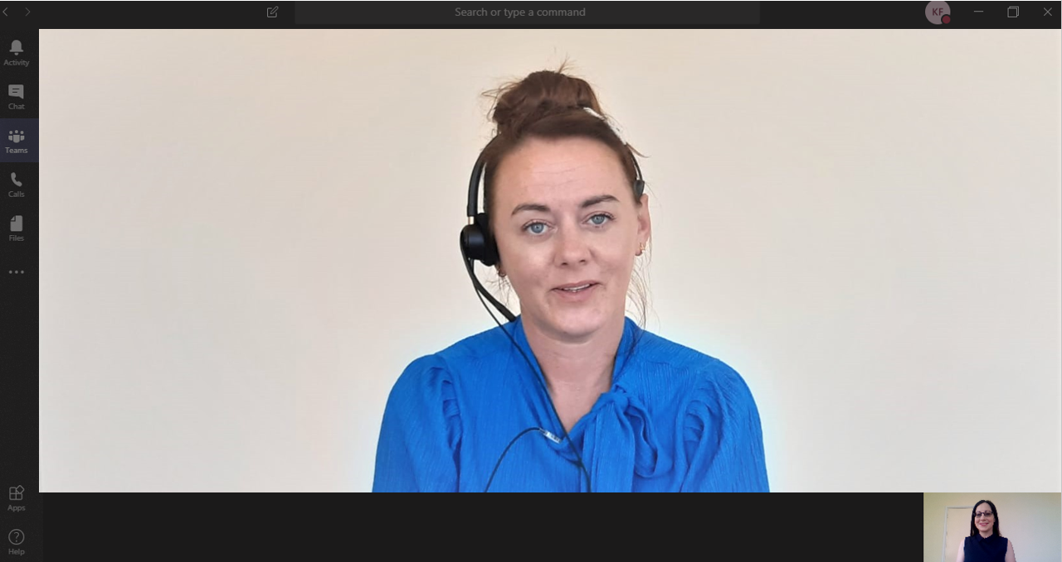
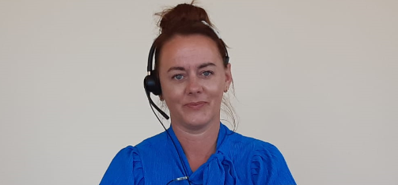
Be prepared - be centred on the screen
This is an example of what the interview board will see if you’re positioned correctly.

Slide 6




Be prepared – your surroundings
Peace & Quiet
Water
Select somewhere quiet, private
and well lit where you won’t
be interrupted. Put your
phone on silent.
Don’t forget to pour yourself a glass of water before the interview.
Be Punctual
Recording
You should log in to Microsoft Teams at least ten minutes in advance to avoid delays and
check sound, camera and backgrounds.
The interview will not be recorded. You are not permitted to record the interview. You should not use the mute function during the
interview.
Notes:
Make sure you choose a onto quite private space where you wont be disturbed. Pour yourself a glasss of water and log onto Microsoft teams at least tem minuet in advance of your secheduled interview time (you could think of this as a virtual waiting room) Recording

Slide 7
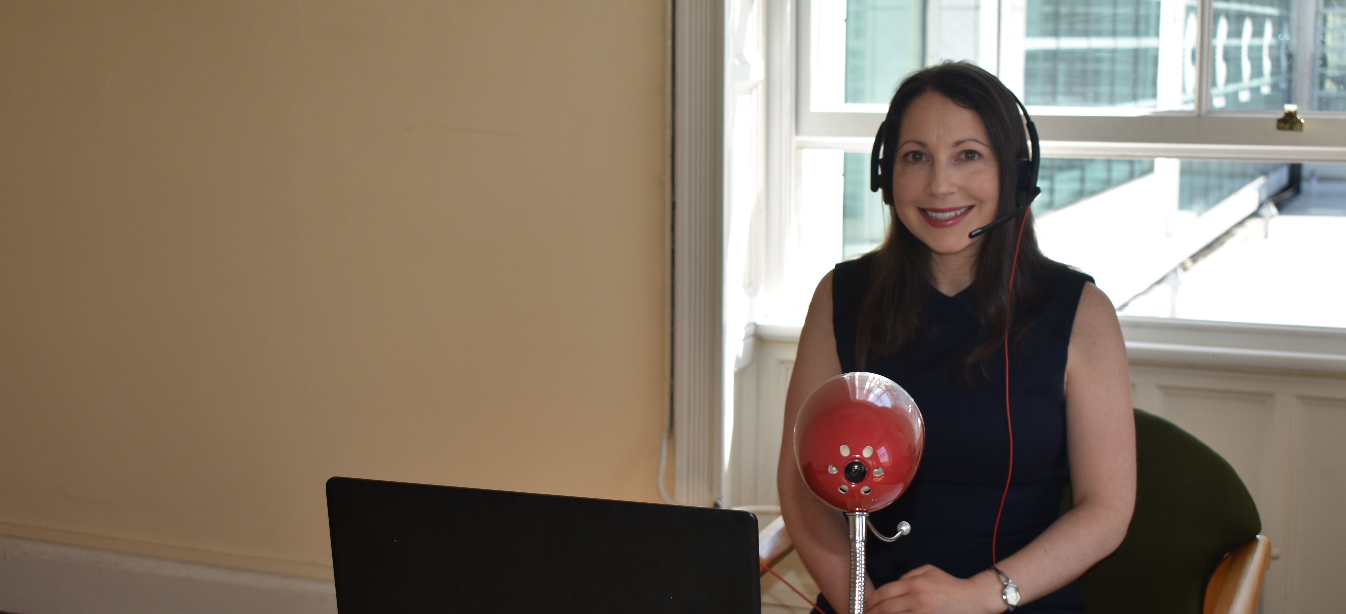
Be prepared - dress professionally
Dress how you would for an in-person interview.
Be mindful that screen cameras often don’t portray bright colours
and patterns very well.
Notes:
Your interview will be formal so dress how you would for an in person interview. Be mindful that etc

Slide 8






Be Prepared - checklist
Tech
Check
Camera
Position
Lighting &
Background
Private
Space
Glass of
Water
Dress
Professionally
Notes:
You might find a preparation checklist useful – so, a quick recap -

Slide 9

The Online Interview
The interview board will log into the meeting at your allocated interview time.
Be patient, this may take a few moments, don’t panic.
The Chairperson will …
confirm your identity
introduce the board members and the
format of the interview
confirm that everyone can see and hear
each other
formally start and end interview

Slide 10
Answering questions during your interview
Look at the Camera
Speak Clearly
Eye contact in an in-person interview is very important and difficult to achieve the same connection via video.
Don’t be afraid to look at the camera when speaking. Your eyes are more likely to align with the interviewers on the other end.
When listening, look at the screen or the camera.
Make sure your speaker isn’t on mute. You should not use the mute option during the interview.
Speak clearly and slowly at a regular volume.
Take into account there may be a slight time delay, wait for the interviewer to finish asking the question before answering.
Notes:
Eye contact is very important during an in-person interview, and you want to convey that same level of connection during a video interview. Here’s how: Avoid the instinct to look directly at your interviewer on the screen while you’re answering a question. Instead, when you speak, you want to direct your gaze at the camera. When you do this, your eyes are more likely to align with the interviewer’s eyes on the other end. When you’re listening, you can look back at the screen.
When listening, nod and smile as you normally would in an interview. Use hand gestures if that’s what you’re comfortable with. Otherwise place them on your lap or table. Avoid looking around you and away from the screen
Have good posture – sit in the chair with your back straight and feet planted on the floor.
If you normally use hand gestures, do it if it feels appropriate. Don’t be afraid to nod and smile.
Avoid getting distracted and looking away from the screen.

Slide 11




Thank you for applying to work with us in Cork City Council.
Wishing you the best of luck in your interview
www.corkcity.ie

